Slide 1





Chapter 8. Fluid Navigation Team 2
Vipul Chandoor
Sneha Madhavaram
Rakesh Varma Nadakudhiti
Venkata Sai Karthik Reddy Bijjam
Divyaharshini Bheemireddy

Slide 2
Topics
Introduction
Navigation by selection
Small displays
Content Organization
Audio menus
Form fill-in and dialog boxes

Slide 3

1. Navigation by selection
Enables users to know where they are and to steer themselves to their intended destination
Is about getting work done or having fun through a series of actions, much like sailors who steer their boat to a harbor

Slide 4
3 ways of Navigations
Task Navigation
Web Navigation
Command Menu Navigation

Slide 5
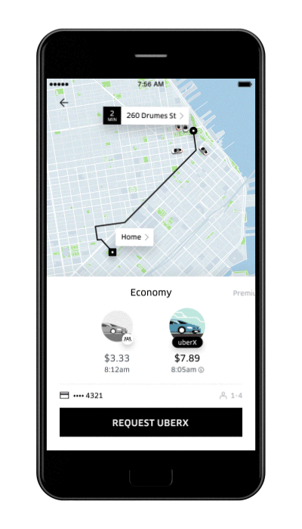
Task Navigation
successfully operating interactive applications, such as installing a mobile app, completing an on-line survey, or purchasing a train ticket.
Doing some work to complete the task will comes under task navigation
Booking Uber is a task which is shown.

Slide 6

Web Navigation
finding information on a website or browsing social media
Navigation planning
Navigation bar design
User friendly language
Link the logo to the home page
Primary / Secondary

Slide 7
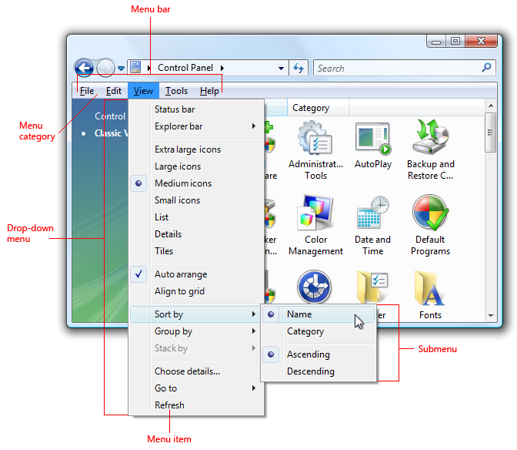
Command menu Navigation
finding the action needed in a desktop application
Types of menu Navigations:
Menu Bars
Toolbar Menus
Tab Menus
Context Menu
Task pane Menu

Slide 8
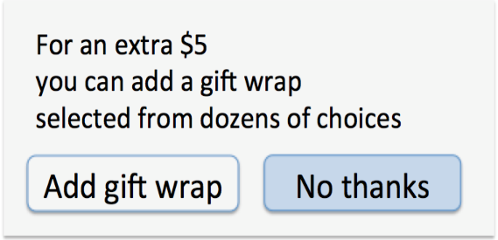
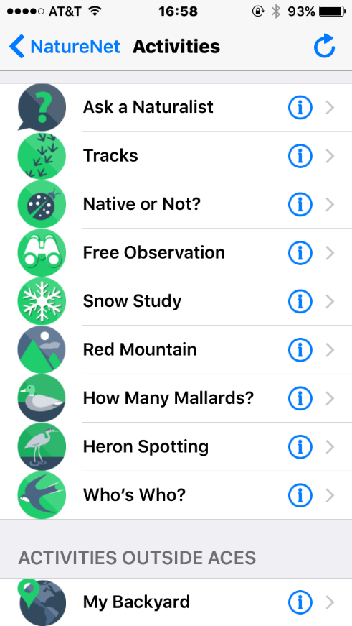
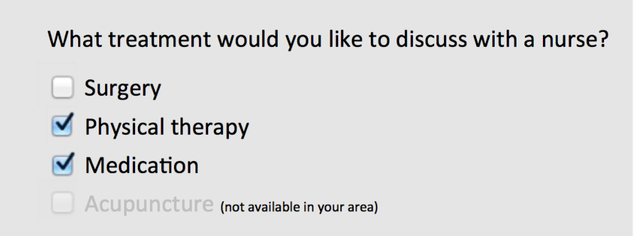
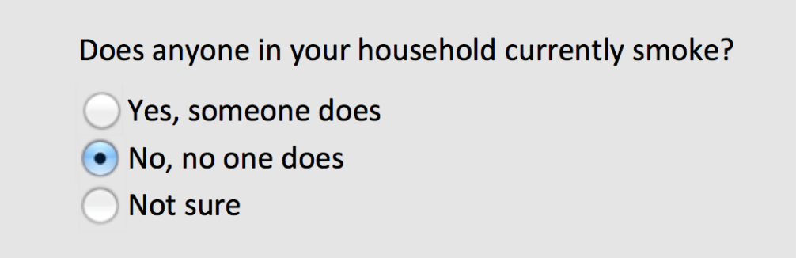
Navigations
Menu bars, pop-up menus, toolbars, palettes and ribbons
Shortcuts and gestures for rapid interaction
Long lists
Linear versus simultaneous presentation
Radio Buttons
Check Boxes

Slide 9
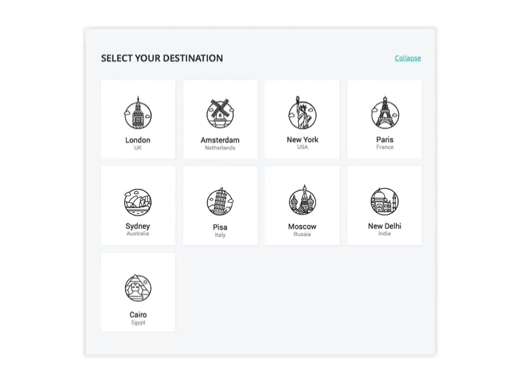
Card Grid for Responsive Navigation

Slide 10
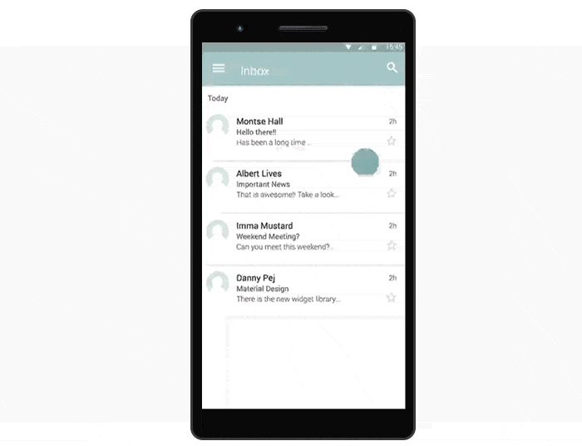
Sliding Hamburger Navigation

Slide 11
Examples of common gestures and their effect:
Tap: select
Long press: varied, from magnified cursor (iOS) to showing a tooltip (Windows 8)
Double tap: varied, e.g. zoom (iOS)
Small swipe: varied, e.g. move location or order of objects, reveal a delete button
Large swipe: usually scroll
Rapid swipe or fling: fast scroll with inertia
Pinch and spread: zoom in and out
Variation with two or more fingers: varied effects

Slide 12
SMALL DISPLAYS
Handheld portable digital devices nowadays often include wireless network connectivity, with extensions such as a mobile phone, Bluetooth connections, a camera and a variety of add-on hardware and software. These handheld mobile-enabled devices are sometime called Personal Digital Assistants (PDAs), Pocket PCs, ‘‘smartphones’’ , ‘‘wearables’’ , ‘‘communicators’’ or ‘‘mobile multimedia machines’’.
Sneha Madhavaram

Slide 13
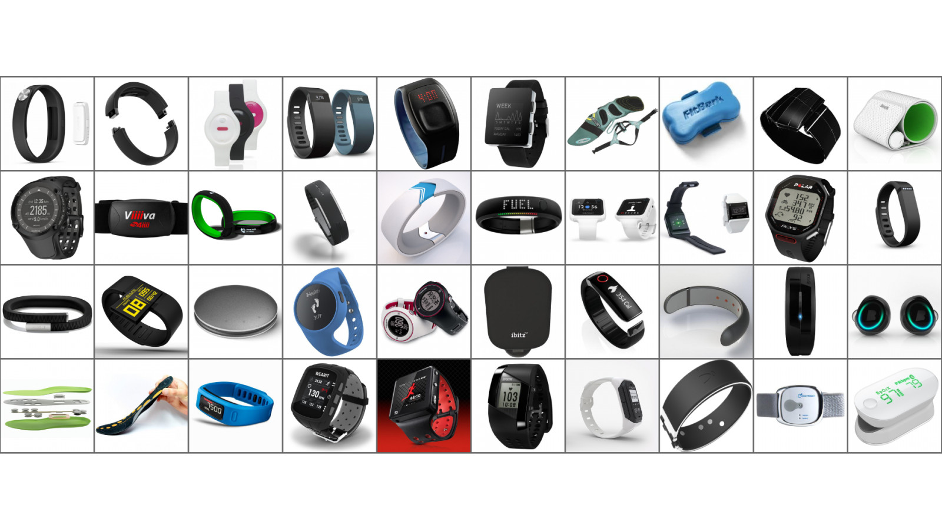

Slide 14
Whenever we design menus for small screens we need to reduce the complexity of options in particular menu in order to do that we need to decrease the option in a single menu by dividing the options into different categories.
Discoverability is often an issue.
Sneha Madhavaram

Slide 15
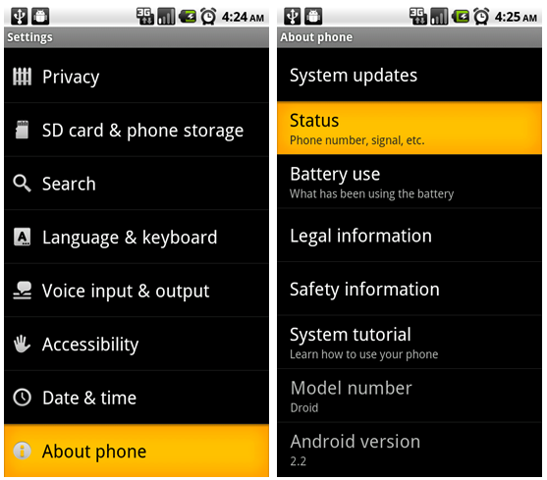

Slide 16
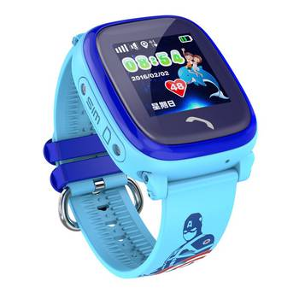
Design considerations for small displays:
Simplify: “less is more”
Strive to reduce or eliminate data entry
Learnability is key
Consider use frequency and
importance
Use of contextual information
Sneha Madhavaram
Notes:
1.keep useful information
2.

Slide 17
Design considerations for small displays:
Make clear what is selectable and what is not
Leave room for scroll and swipe gestures to avoid inadvertent actions.
Consider relegating less important functions to other platforms
Sneha Madhavaram

Slide 18
Content Organization
Content Organization gathers a list of the necessary content and organize that content relative to user's needs.
Task-related grouping in tree structures:
Create groups of logically similar items.
Form groups that cover all possibilities.
Make sure items are not overlapping.
Use familiar terminology, but ensure that items are distinct from one another.
Rakesh Varma Nadakudhiti
Notes:
Create groups of logically similar items. For example, a comprehensible menu would list countries at level 1, states or provinces at level 2, and cities at level 3. Form groups that cover all possibilities. For example, a menu with age ranges 0-9, 10-19,20-29, and> 30 makes it easy for the user to select an item. Make sure that items are llolloverlappil1g. Lower-level items should be naturally associated with a single higher-level item. Overlapping categories such as "Entertainment" and "Events" are poor choices compared to "Concerts" and "Sports." Use familiar terminology, but ensure that items are distinct from one another. Generic terms such as "Day" and "Night" may be too vague; more specific options such as "6 A.M. to 6 P.M." and "6 P.M. to 6 A.M." may be more useful and precise

Slide 19
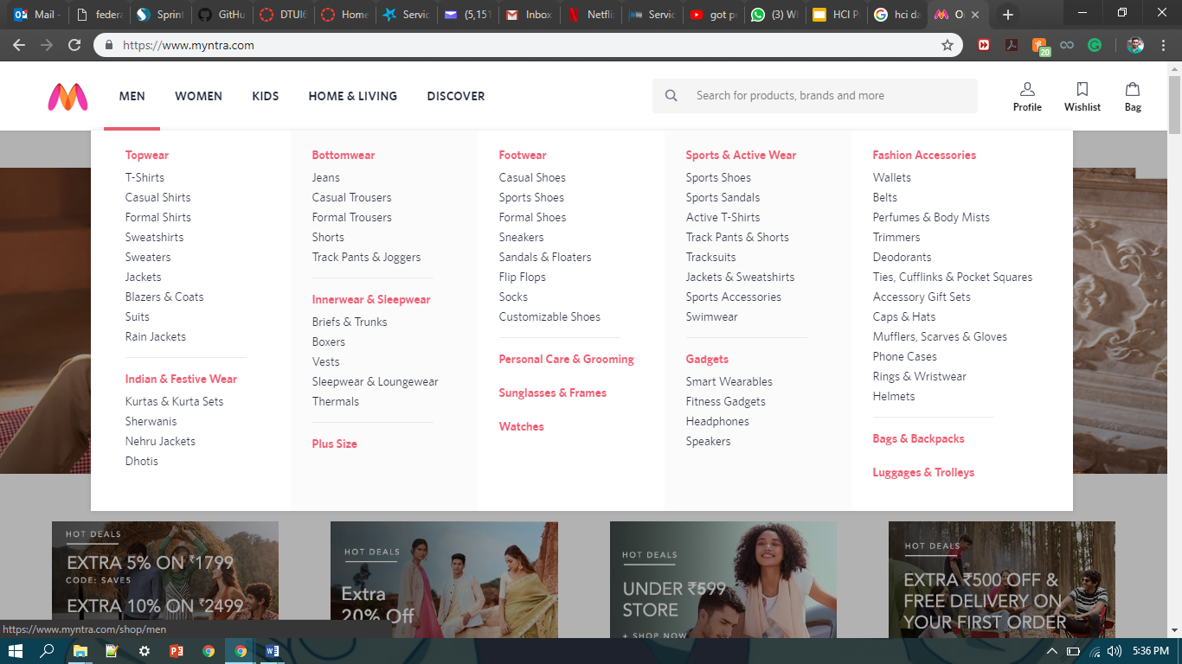
Notes:
Reference - https://www.myntra.com/

Slide 20
Content Organization
Item presentation sequence:
The order of items in the menu is important, and should take natural sequence into account when possible:
Time
Numeric ordering
Physical properties
When cases have no task-related orderings, the designer must choose from such possibilities as:
Alphabetic sequence of terms
Grouping of related items
Most frequently used items first
Most important items first
Rakesh Varma Nadakudhiti
Notes:
Numeric ordering (ascending or descending ordering) Physical properties (increasing or decreasing length, area, volume, temperature, weight, velocity, and so on) Grouping of related items (with blank lines or other demarcation between groups) Most important items first (importance may be difficult to determine and may
vary among users)

Slide 21
Content Organization
Menu Layout:
Use familiar and consistent terminology.
Ensure that items are distinct from one another
Use consistent and concise phrasing.
Bring the keyword to the fore
Rakesh Varma Nadakudhiti
Notes:
Carefully select terminology that is familiar to the designated user community and keep a list of these terms to facilitate consistent use. • Ensure that items are distinct from one another. Each item should be distinguished clearly from other items. Use consistent and concise phrasing. Review the collection of items to ensure consistency and conciseness. Users are likely to feel more comfortable and to be more successful with "Animal," "Vegetable," and "Mineral" than with "Information about animals," "Vegetable choices you can make," and "Viewing mineral categories." • Bring the keyword to the fore. Try to write menu items such that the first word aids the user in recognizing and discriminating between items-use "Size of type" instead of "Set the type size." Then, if the first word indicates that this item is not relevant, users can begin scanning the next item

Slide 22
Audio Menus and Interfaces
Audio menus and interfaces can be defined as media that allow humans to interact with computers through a voice/speech platform
When user hands and eyes are busy, such as when they are driving or testing equipment's, audio menus would be useful, since the users can only use speech to make their choice.
Audio menus are also important in telephone interfaces, since it is not possible to display the options for the caller to see; the options need to be read out.

Slide 23
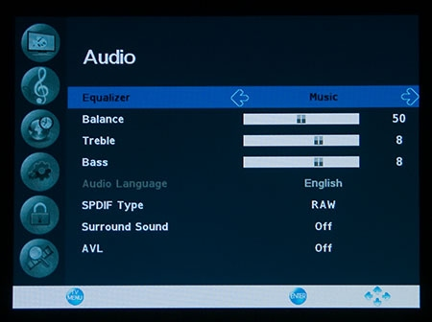
Various Instances of Audio Menus and Voice User Interfaces
With audio menus, instruction prompts, and arrangements of choices are addressed to the user, and the user reacts by utilizing the keys of a console or touch-tone phone, or by talking

Slide 24
Virtual Assistant
Virtual assistant is also one of the example for Audio Menus and Voice user interfaces.
It uses voice queries and a natural-language user interface to answer questions, make recommendations, and perform actions.
At present we have many of virtual assistants.
Google Assistant, Siri, Google now, Cortana, Amazon Echo, Nina, BlackBerry Assistant are some of the examples of the virtual assistants.

Slide 25
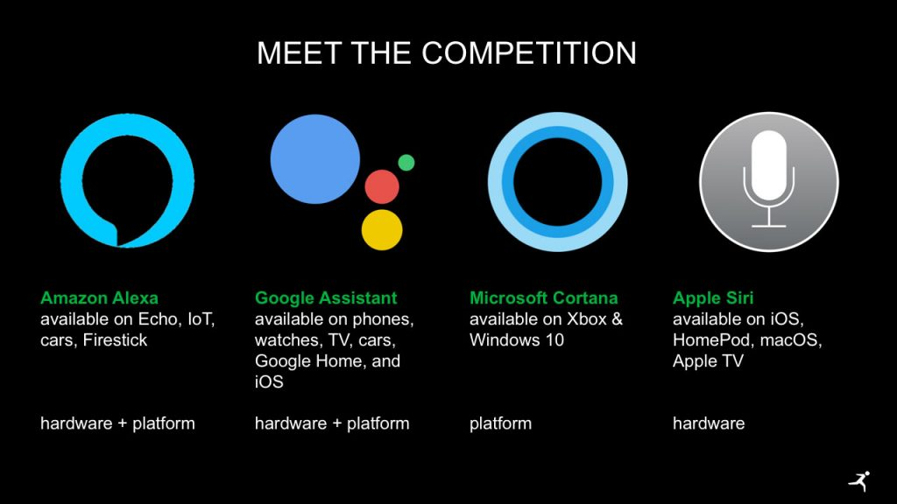

Slide 26
Interactive Voice Response (IVR) System
Another example of voice user interface is Interactive Voice Response (IVR) System
This IVR System is an automated telephony system that interacts with callers, gathers information and routes calls to the appropriately.
It allows users to interact with the company’s database via a telephone keypad or via speech recognition
The system can respond with pre-recorded or dynamically generated audio to further direct the users on how to proceed.
Notes:
https://www.youtube.com/watch?v=fQPYuvU-zYI

Slide 27
GENERAL STRUCTURE OF A SPEECH-ENABLED SYSTEM
Speech enabled system consists of 4 components:
A speech recognizer
A speech analyzer
A dialogue controller
A speech synthesizer / speech generator
Notes:
1. A speech recognizer, which converts acoustical input into text strings.
2. A speech analyzer to extract the meaning of the recognized text.
3. A dialogue controller that performs predefined actions based on the extracted commands.
4. A speech synthesizer (or speech generator) to generate acoustical output from the system’s answer

Slide 28
Advantages
When users hands and eyes are busy, or users are handicapped, voice user interface has a clear advantage over graphic user interface
Under harsh user not able to use a keyboard (e.g. in underwater or rescue operations), voice user interfaces perform better than graphic interfaces
Notes:
When there is a Disturbance in background it is hard to read user voice accurately
Recognition errors might occur for similarly-pronounced words (such as dime/time or Houston/Austin).
Unstable recognition across changing users, environments, and time. This is because people from different regions might have different ways to pronounce of certain words, hence the system might not be able to recognize them.

Slide 29
Disadvantages
The presence of background noise might have unwanted effects on the accuracy of the input that was read in, and what the users originally said
Recognition errors might occur for similarly-pronounced words.
Unstable recognition, people from different regions might have different ways to pronounce of certain words, hence the system might not be able to recognize them.
When users are driving, voice user interface might become a distraction

Slide 30
Form Fill-in and Dialog Boxes
Form Fill-in is a mean for interactive system to ask data or information from users.
The user type the data in specific field
Appropriate when many fields of data must be entered
The TAB-key is used to switch among the various fields. The data in the form must be listed in the pre – defined form fields.
Divyaharshini Bheemireddy

Slide 31
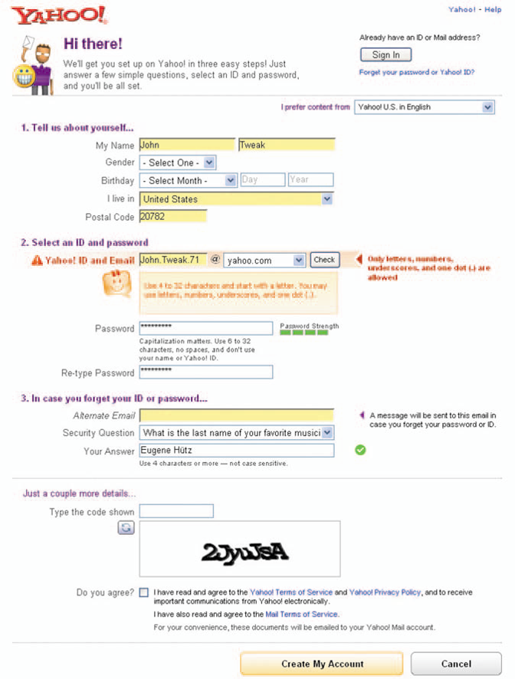
Form Fill-in
Fill-in application form:
Divyaharshini Bheemireddy

Slide 32
Data Entry with Form Fill-in
Form Fill-in
Appropriate when many fields of data must be entered:
Full complement of information is visible to user
Display resembles familiar paper forms
Few instructions are required for many types of entries
Users must be familiar with:
Keyboards
Use of TAB key or mouse to move the cursor
Error correction methods
Field-label meanings
Permissible field contents
Use of the ENTER and/or RETURN key
Divyaharshini Bheemireddy

Slide 33
Note to Users:
1.Fields mark with asterisk (*) are mandatory fields
2.User can use “Save” function to save the unfinished application for continuous action before submission
Format-specific field:
Coded fields
Telephone numbers
Social-security numbers
Times Dates
Dollar amounts (or other currency)
Divyaharshini Bheemireddy

Slide 34
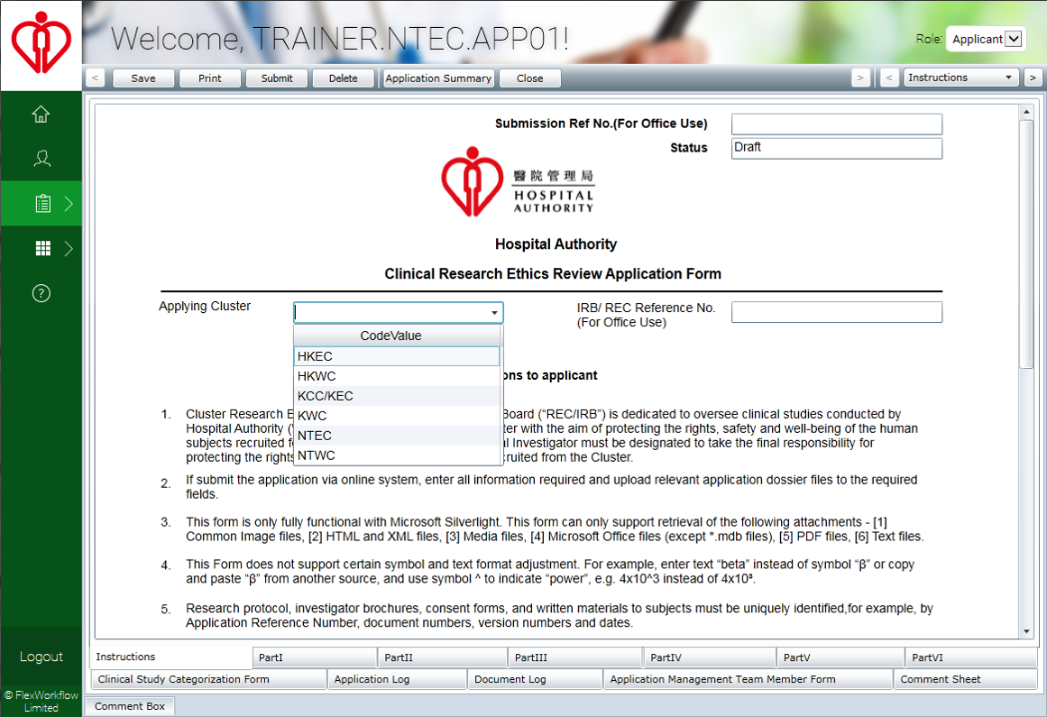
Divyaharshini Bheemireddy

Slide 35
Dialog Boxes
This dialog box includes a binary menu with two choices (Yes & No).
The blue highlighting on Yes indicates that this selection is the default and that pressing Return will select it.
Specific keyboard shortcuts can be made available.
Escape closes the dialog box.
Typing the letter ‘N’ will select ‘No’ as indicated by the underlined letter ‘N’.
Divyaharshini Bheemireddy

Slide 36
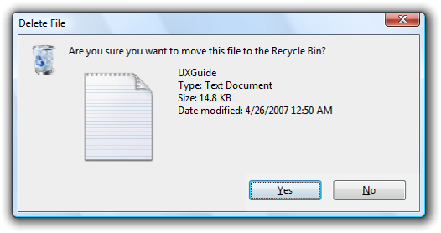
Dialog Box
Divyaharshini Bheemireddy

Slide 37
Data Entry with Dialog Boxes
Dialog Boxes
­Combination of menu and form fill-in techniques.
­Internal layout guidelines:
­Meaningful title, consistent style
­Consistent layouts (margins, grid, white space, lines, boxes)
­Fonts, capitalization, justification
­Standard buttons (OK, Cancel)
­Error prevention by direct manipulation
Divyaharshini Bheemireddy

Slide 38
Data Entry with Dialog Boxes
External Relationship
­Distinguishable but small boundary
­No overlap of required items
­Easy to make disappear
­Clear how to complete/cancel
Divyaharshini Bheemireddy

Slide 39
Thank You

